Slide 1
Session 10: ERC BASICS
HORIZON EUROPE

Slide 2
Scientific Excellence as sole criterion
Scientific Autonomy
Portability of grants
Ground-breaking
Frontier Research
Investigator-driven
High risk – high gain
All research fields “Bottom-Up”
Notes:
Features of ERC funding:
Scientific excellence as the sole selection criterion
an innovative idea for a research project at the frontiers of science,
an excellent scientific track record (publications and other achievements)
Funding for groundbreaking frontier research: The ERC supports basic research characterized as frontier research. These terms refer to groundbreaking and visionary research that removes the boundaries between basic and applied research, between classical disciplines and between research and technology. Research funded by the ERC is expected to lead to advances at the frontiers of knowledge and to set a clear and inspirational target for frontier research across Europe.
The ERC puts particular emphasis on the frontiers of science, scholarship and engineering. In particular, it encourages proposals of a multi- or interdisciplinary nature which cross the boundaries between different fields of research, pioneering proposals addressing new and emerging fields of research or proposals introducing unconventional, innovative approaches and scientific inventions.
High risk-high gain: To what extent is the proposed research high risk-high gain (i.e. if successful the payoffs will be very significant, but there is a high risk that the research project does not entirely fulfil its aims)?
Complete openness of projects to topics (bottom-up), no predetermined priorities
Application as sole applicant possible (no consortia!)
Personal, i.e. the submission is made by a PI with a host institution.
Individual researchers and their teams will be funded
If you wish to change the HI – for example because someone offers you better working or research conditions elsewhere – you can change the Host institution and take the grant with you.
Autonomy of science - The ERC is chaired by a high-ranking scientific council and its president. Autonomy of science "From scientists for scientists". Unbureaucratic and transparent procedures. Science-driven

Slide 3
ERC target groups
Starting Grants: excellent PIs at the career stage at which they are starting their own independent research team/programme
Consolidator Grants: excellent PIs at the career stage at which they may still be consolidating their own independent research team/programme
Advanced Grants: excellent PIs at the career stage of already established research leaders with a recognised track record of research achievements

Slide 4
ERC Grant Schemes (I/II)
 | Starting Grants | Consolidator Grants | Advanced Grants | Synergy Grants | Proof of Concept
Target group | scientists 2-7 years after PhD | scientists 7-12 years after PhD | Established scientists | 2-4 scientists | ERC Grantees
Max. duration | 5 years | 5 years | 5 years | 6 years | 18 months
Max. budget | 1.5 Mio. € (2.5 Mio.€)* | 2 Mio. € (3 Mio.€)* | 2.5 Mio. € (3.5 Mio.€)* | 10 Mio. € (14 Mio. €)* | 150 000 €
* Additional costs in case of high equipment costs or PI from Third Country, other major experimental and field work costs, excluding personnel costs
Notes:
The ERC awards funding to excellent investigators looking to set up or consolidate their own independent research team or programme, as well as to already established research leaders.
The ERC is split into three main funding lines which have deadlines every year.
The main difference is the target group which is nothing you can freely chose.
Depending on the date of your PhD you fall into one of these three categories.
Starting grants are for top researchers 2- 7 years after having completed their PhD
Consolidator Grants are for researchers 7-12 years after PhD
Advanced grants have no specific reference date. Applicants may be at any stage of their research career if they have a track-record of significant research achievements of the last 10 years.
The maximum period of funding for Starting Grants, Consolidator Grants and Advanced Grants is five years.
In 2018 the ERC is going to publish again a Synergy Grants Call for teams of up to 4 researchers. I will come to that funding line later.
The maximum grant varies by grant type. An ERC grant can cover up to 100% of the total eligible direct costs of the research plus a contribution towards indirect costs.
In some circumstances the budget can be higher
For example if you need access to infrastructure or high equipment costs
Or in case the PI comes from a third country
Today I won‘t get into detail about the proof-of-concept scheme wich is for ERC grant holders who want to establish the innovation potential of ideas from their ERC-funded projects.
Additional funding up to the amounts set out in the table below can be requested in the proposal to cover the following eligible costs when these are necessary to carry out the proposed work: (a) "start-up" costs for Principal Investigators moving to the EU or an Associated Country from elsewhere as a consequence of receiving the ERC grant and/or (b) the purchase of major equipment and/or (c) access to large facilities and/or (d) other major experimental and field work costs, excluding personnel costs.
Additional funding is not subject to pro rata temporis reduction for projects of shorter duration.
All funding requested is assessed during evaluation.
Principal Investigators must demonstrate the ground-breaking nature, ambition and feasibility of their scientific proposal.
Scientists who have already received an ERC grant may reapply before the end of the project. The prerequisite is that the existing project ends at the latest two years after the deadline for the new call. The relevant date is the end date of the existing project, as specified in the Grant Agreement. They are subject to the same rules and selection procedure as all other applicants. However, a person may not hold two grants at the same time. This means that the first project must be completed before the second can begin.

Slide 5
ERC Grant Schemes (II/II)
 | Starting Grant | Consolidator Grant | Advanced Grant | Synergy Grant
On the ERC project | 50% | 40% | 30% | 30% (each PI)
In the EU / AC | 50% | 50% | 50% | 50% (for each PI with a Host Institution in the EU/AS)
Notes:
Minimum time commitment
Principal Investigators funded through the ERC frontier research grants shall spend a minimum percentage of their working time on the ERC project and a minimum percentage of their working time in an EU Member State or Associated Country as set out in the table.
The applicants are expected to spend at least 50% or 40% of their working time on the ERC project. At the same time, they should spend at least 50% of the total amount of time in Europe.
The evaluation panels will determine whether the PI is strongly committed and if they spend enough time on the project. All proposals should therefore state clearly the amount of active time the PI spends on the project. Every uncertainty should be avoided.
The ERC funding is granted to the individual person and thus asks for a considerable contribution of the PI. The ERC is looking for active researchers, who not only lead the project but are also involved in research to a considerable amount. The proposal should state that the future ERC project will be the main interest of the PI in the coming years.

Slide 6
ERC Starting Grants – Overview
Target group | 2-7 years after PhD (extensions possible in exceptional cases; special rules for MD)
Funding | max. EUR 1.5 million for max. 5 years (exception: + EUR 1 million e.g. for major equipment or access to large facilities)
Host institution | in EU Member State or Associated Country
Time commitment | ≥ 50% (≥ 50% in Europe)
Procedure | single submission of full proposal, two-step evaluation (incl. interview)
Call | annually

Slide 7
ERC Consolidator Grants – Overview
Target group | 7-12 years after PhD (extensions possible in exceptional cases)
Funding | max. EUR 2 million for max. 5 years (exception: + EUR 1 million e.g. for major equipment or access to large facilities)
Host institution | in EU Member State or Associated Country
Time commitment | ≥ 40% (≥ 50% in Europe)
Procedure | single submission of full proposal, two-step evaluation (incl. interview)
Call | annually

Slide 8
ERC Advanced Grants – Overview
Target group | 1 PI (and team) – from anywhere in world
Benchmark / eligibility | Established researcher, outstanding 10 yr record
Funding | max. € 2.5 Mio. for max. 5 years (exception: + EUR 1 million e.g. for major equipment or access to large facilities)
Host institution | EU Member State or associated country
Time commitment | ≥ 30% time, min. 50% in EU / AC
Submission / evaluation | Single Stage Submission / Two-Stage evaluation Submit via Portal*, using current call documents!
Submission deadline | Annually

Slide 9
Extensions of the eligibility period
Maternity before/after PhD: 18 months per child
Extension by the documented time:
Maternity before/after PhD leave > 18 months
Paternity before/after PhD
Military/civil service after PhD
Long-term illness of the PI or a close family member (>90 days) after PhD
Clinical training after the award of the first eligible degree (up to 4 years)
Notes:
The eligibility periods can be extended beyond 7 and 12 years for the Starting and Consolidator Grants respectively for the following properly documented circumstances (For applicants whose first eligible degree is their medical degree such incidents can be considered from the date of completion of their medical degree), provided they started before the call deadline:
- Maternity: 18 months extension for each child born before or after the PhD award. If the applicant can document a longer maternity leave, the eligibility period will be extended by the documented amount of actual leave taken until the call deadline.
- Paternity: extension by the documented time of paternity leave taken until the call deadline for each child born before or after the PhD award.
- Long-term illness (Over ninety days for the Principal Investigator or a close family member (child, spouse, parent or sibling) or national service: extension by the documented amount of leave taken by the Principal Investigator until the call deadline for each incident which occurred after the PhD award date.
Clinical training: extension by the documented amount of clinical training received by the Principal Investigator after the award of the first eligible degree and until the call deadline, up to a maximum of 4 years.

Slide 10
Funding Modalities
Get in touch with your institution for budget planning
Direct eligible costs, 100%
Salary of PI and project team (Postdocs, PhD Students, Technicians etc.) (partly/full)
Consumables
Equipment Costs (depriciation rates apply)
Travel Costs
Publications Costs (including open access)
Subcontracts and other
Indirect costs, 25% of direct costs

Slide 11
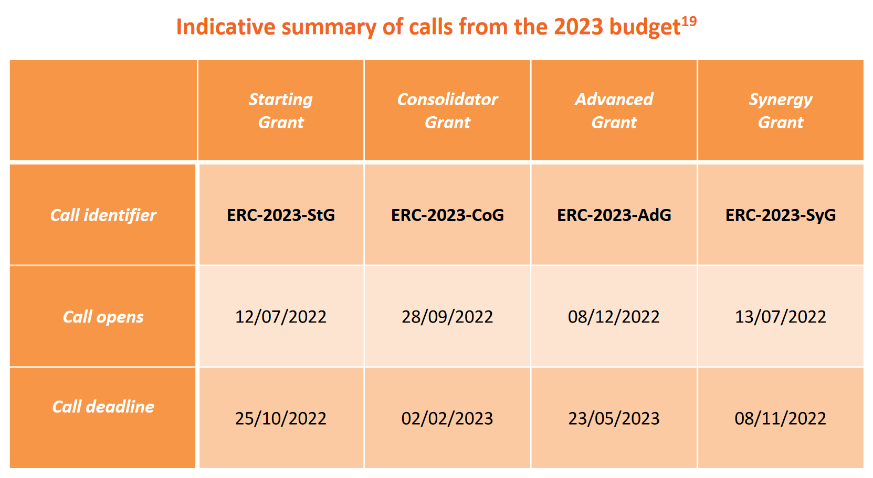
ERC Call calendar 2022/2023

Slide 12
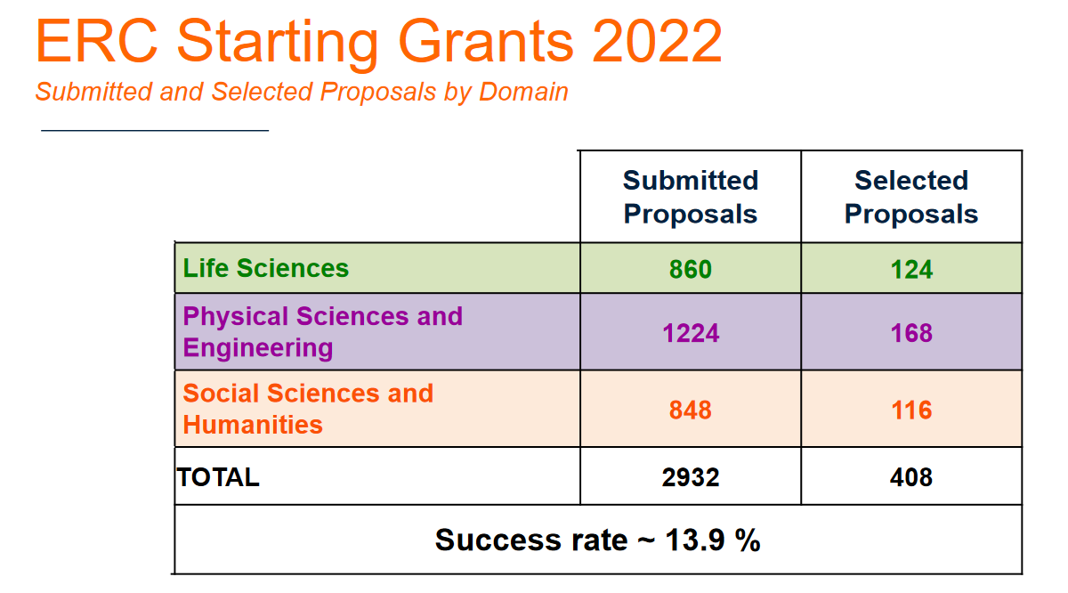
ERC Call statistics 2022

Slide 13
Main Documents to be used
ERC work programme 2023
ERC Rules of submission and evaluation under Horizon Europe
Information for Applicants: call specific, e.g. Advanced Grant 2023
Familiarize yourself early with the evaluation sub-criteria and the electronic submission system
Notes:
Work Programme: Infos on funding lines, eligibility, ERC obejctives and philosophy
Information for applicants:
Eligibility criteria
Application Structure
Formal Parameters (Font type, size etc.)
Online Proposal Submission System
Budget (direct costs, indirect costs, non-eligible costs)
Evaluation criteria and evaluation

Slide 14
One Evaluation Criteria: Excellence
Research Project:
Ground-breaking nature , ambition and feasibility
Address important challenges
Ambitious objectives & beyond the state of the art
High risk / high gain
Scientific Approach
Feasibility
Appropriateness of research methodology to achieve goals
Development of novel methodology
Timescales, resources & time commitment
Principal Investigator
Ability to conduct ground-breaking research
Evidence of creative independent thinking
Scientific expertise & capacity to execute the project
Notes:
Evaluation criteria
For all ERC frontier research grants, scientific excellence is the sole criterion of evaluation. It will be applied in conjunction to the evaluation of both: the ground-breaking nature, ambition and feasibility of the research project; and the intellectual capacity, creativity and commitment of the Principal Investigator.
Individual sub-criteria are assigned in the Guide to B1, B2 or both.
During the evaluation, the phase of the Principal Investigator's transition to independence, possible breaks in the research career of the applicant and/or unconventional research career paths should be taken into account.
Ground-breaking nature and potential impact of the research project
To what extent does the proposed research address important challenges?
To what extent are the objectives ambitious and beyond the state of the art (e.g. novel concepts and approaches or development between or across disciplines)?
To what extent is the proposed research high risk-high gain (i.e. if successful the payoffs will be very significant, but there is a high risk that the research project does not entirely fulfil its aims)?
Scientific Approach
To what extent is the outlined scientific approach feasible bearing in mind the extent that the proposed research is high risk/high gain (based on the Extended Synopsis)?
To what extent are the proposed research methodology and working arrangements appropriate to achieve the goals of the project (based on the full Scientific Proposal)?
To what extent does the proposal involve the development of novel methodology (based on the full Scientific Proposal)?
To what extent are the proposed timescales, resources and PI commitment adequate and properly justified (based on the full Scientific Proposal)?
Intellectual capacity and creativity
Starting and Consolidator
To what extent has the PI demonstrated the ability to conduct ground-breaking research?
To what extent does the PI provide evidence of creative independent thinking?
To what extent does the PI have the required scientific expertise and capacity to successfully execute the project?

Slide 15
Evaluation Basics
2 stage evaluation, stage 1 only B1 will be reviewed
Peer-review: research field specific evaluation panels consisting of 1 panel chair and 10-15 members
Three scientific domains:
Physical Sciences & Engineering (PE): 11 panels
Life Sciences (LS): 9 panels
Social Sciences & Humanities (SH): 7 panels
Applicants choose panel and indicate one or more keywords
Up to 3 reviewers can be excluded in advance
+ External reviewers in Stage 2 of the evaluation + Interviews for StG,CoG, AdG and SyG

Slide 16
INFORMATION AND ADVICE For questions and advice please contact your National Contact Points MSCA & ERC https://ec.europa.eu/info/funding-tenders/opportunities/portal/screen/support/support Please find the work programme and calls in the Funding & Tenders Portal https://ec.europa.eu/info/funding-tenders/opportunities/portal/screen/programmes/horizon
Notes:
Closing slide was missing.
I suppose we should include a contact for ISF advice & general ISF e-mail in case of questions?

